Slide 1


CHAPTER 2
FOUR OPERATIONS

Slide 2
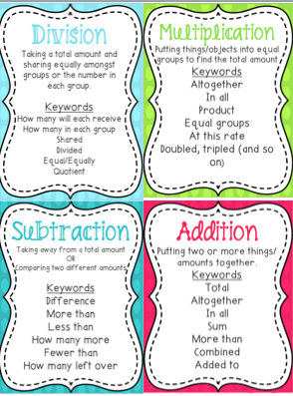
By Four operations in Mathematics, we mean Addition, Subtraction, Multiplication and Division. Mastering them is one of the keys to progressing in understanding of mathematics.
In this Chapter we will learn to perform mathematical operations on larger numbers. First we will learn Addition of larger numbers.

Slide 3
In this Power Point Presentation, we will learn
Fill in the blank boxes
Find the sum by changing into multiples of 10 or 100

Slide 4

3 - Fill in the blank boxes – For these types of questions we will put on our thinking cap and apply our reasoning skills to fill the blank boxes in the addition sum.
Ques:
 | L | T Th | Th | H | T | O
 | 4 | 2 |  | 9 | 5 | 3
+ |  | 5 | 3 | 8 | 1
 | 7 | 8 | 0 |  | 7 | 0

Slide 5
In Ones column, if we take 7 we will have
3 + 7 which will give us 0 at ones place and 1 will be carry over at tens column.
So, in Tens column we get 1 + 5 + 1 = 7.
 | L | T Th | Th | H | T | O
 |  | 1 | 1 |  | 1
 | 4 | 2 | 6 | 9 | 5 | 3
+ | 3 | 5 | 3 | 8 | 1 | 7
 | 7 | 8 | 0 | 7 | 7 | 0
In Hundreds column, we have 9 + 8 which gives us 17. So, we will write 7 in hundreds column and 1 will get carry over at thousands column.
In Thousands column, we have 1 + ? + 3 = 0. If we take 6 in place of ?, we will get 10, that would give us 0 at thousands column and 1 will get carry over at ten thousands column.
So, in Tens Thousands column we get
1 + 2 + 5 = 8.
In Lakhs column, if we take 3 we will get
4 + 3 which will give us 7.

Slide 6
4 – Find the sum by changing numbers into multiples of 10 or 100 – In these types of questions we will change any one of the numbers into multiple of 10 or 100 and then add.
Ques: a) 55 + 43
b) 98 + 71
We will increase one of the addends and decrease the other one with the same number.

Slide 7
a) 55 + 43
b) 98 + 71
Step 1: Add 5 to 55
55 + 5 = 60 (multiple of 10)
Step 1: Add 2 to 98
98 + 2 = 100 (multiple of 100)
Step 2: Subtract 5 from 43
43 – 5 = 38
Step 2: Subtract 2 from 71
71 – 2 = 69
Step 3: The final sum is :
60 + 38 = 98
Step 3: The final sum is :
100 + 69 = 169

Slide 8

FEATURES
Mention date whenever you start your work.
Write neatly with a blue pen.
Draw finishing line after every question.
Recheck for silly mistakes.

Slide 9
Assignment
Exercise 2A
Q3. a), b)
Q4. a), c), e), g)

Slide 10
Hope you enjoyed the learning

